Slide 1


CASToR reconstruction for 131 Iodine GATE Simulations
João Henrique Martins Castelo
Undergraduate student
Medical Physics Federal University of Rio de Janeiro, Brazil
Institute of Radiationprotection and Dosimetry, Rio, Brazil

Slide 2
How to reconstruct images of data acquired from Monte Carlo simulations?

Slide 3
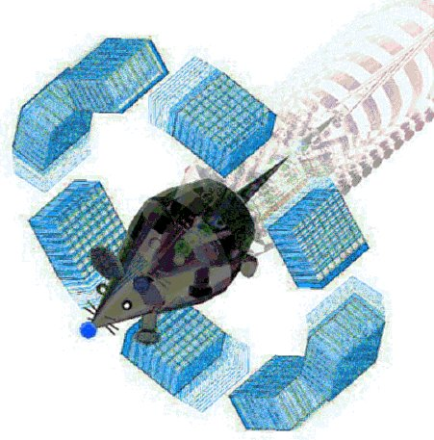
GEANT4 APP FOR TE
GATE

Slide 4





Slide 5
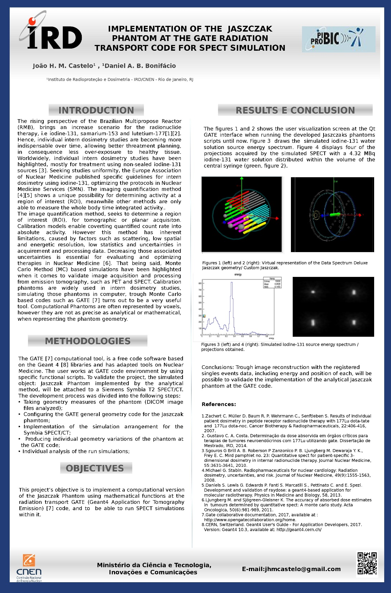
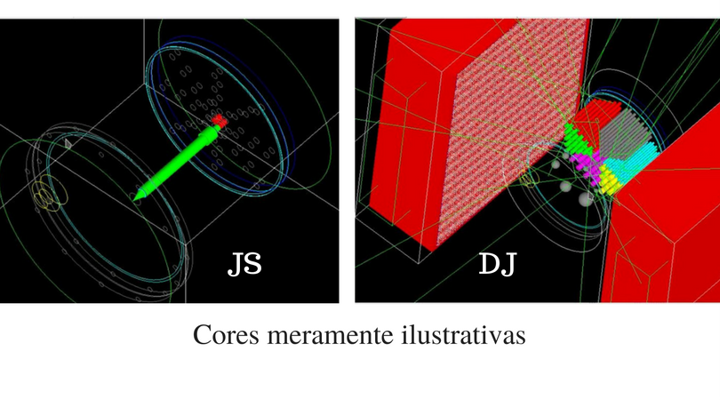

Slide 7
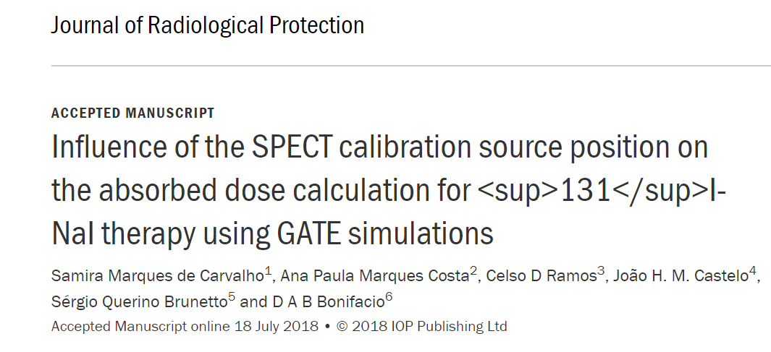

Slide 8
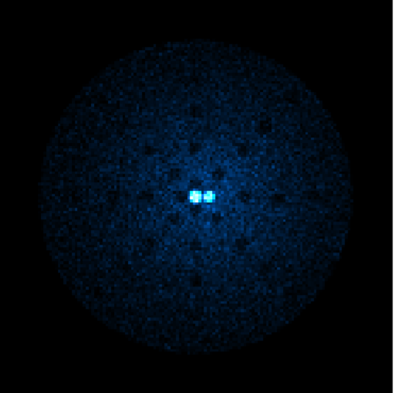
3D Dose Distribution

Slide 9
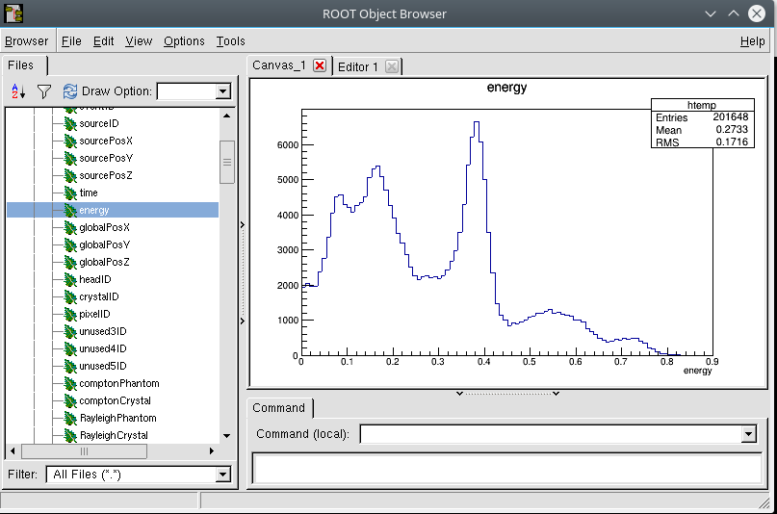


Slide 10
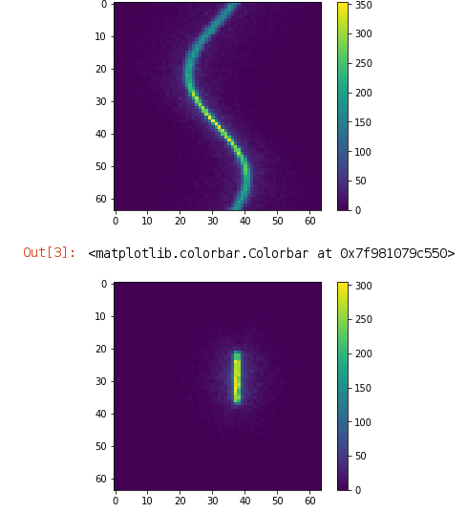
Projections

Slide 11
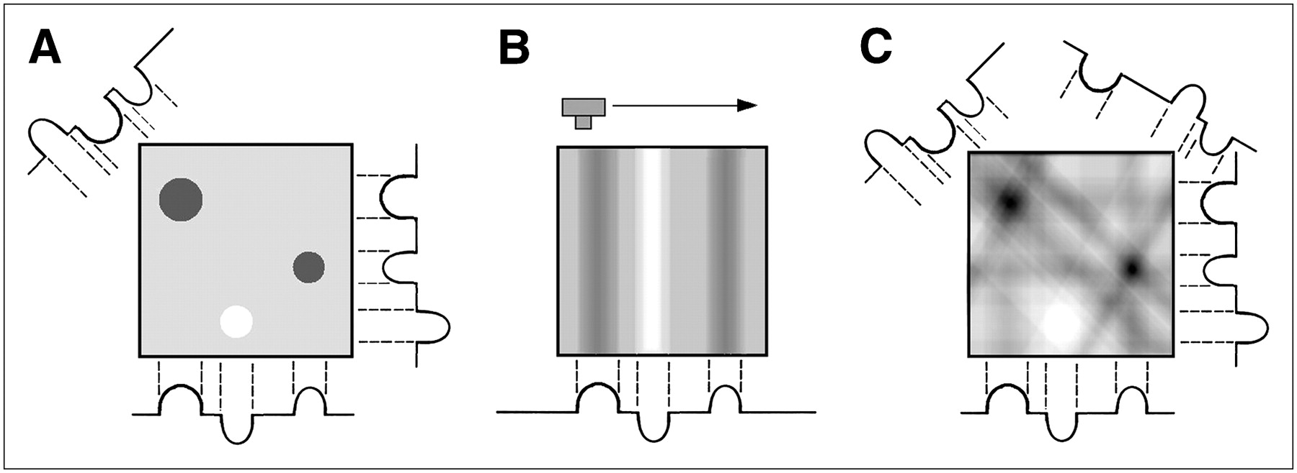
Possible path?

Slide 12
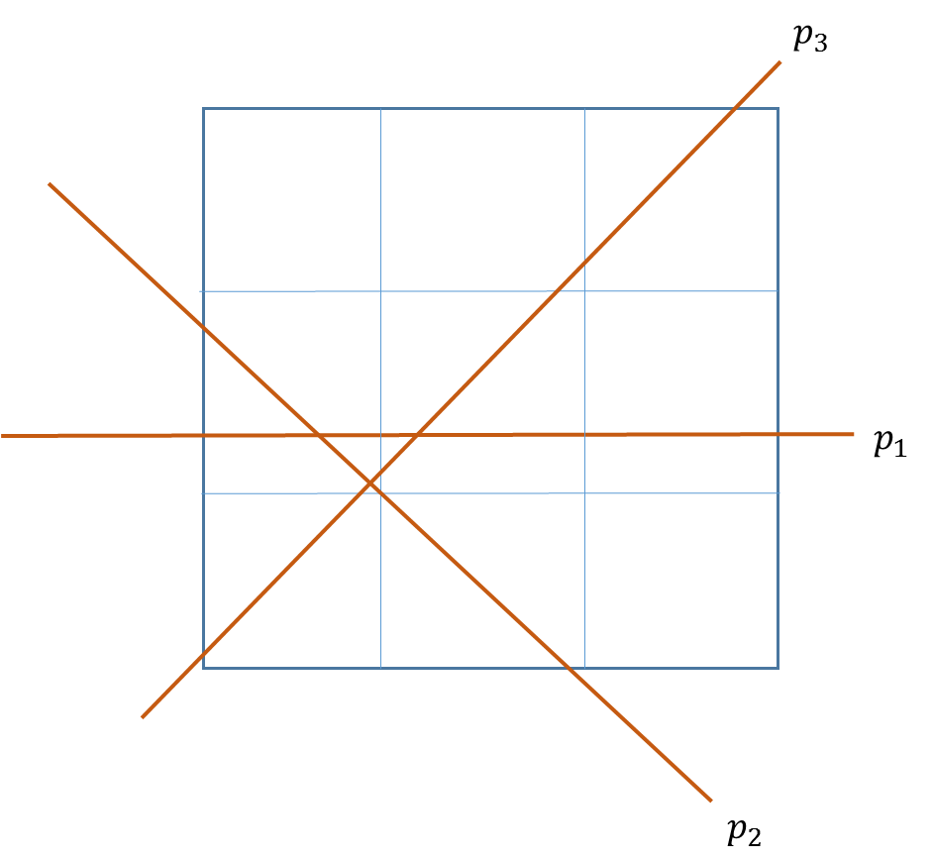
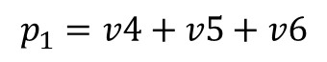
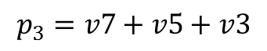
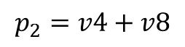
$$p_{1}=v4+v5+v6$$
$$p_{2}=v4+v8$$
$$p_{3}=v7+v5+v3$$

Slide 13
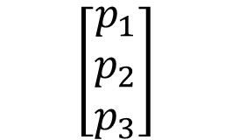
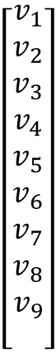
$$\left[\begin{aligned}v_{1} \\ v_{2} \\ v_{3} \\ v_{4} \\ v_{5} \\ v_{6} \\ v_{7} \\ v_{8} \\ v_{9} \\ \end{aligned}\right]$$
0 0 0 1 1 1 0 0 0
0 0 0 1 0 0 0 1 0
0 0 1 0 1 0 1 0 0
$$\left[\begin{aligned}p_{1} \\ p_{2} \\ p_{3}\end{aligned}\right]$$

Slide 14
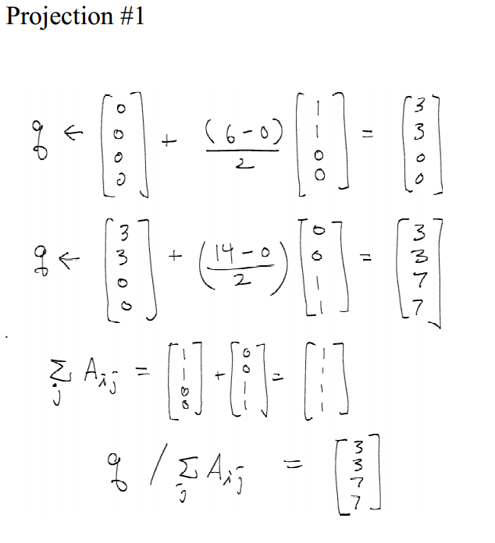
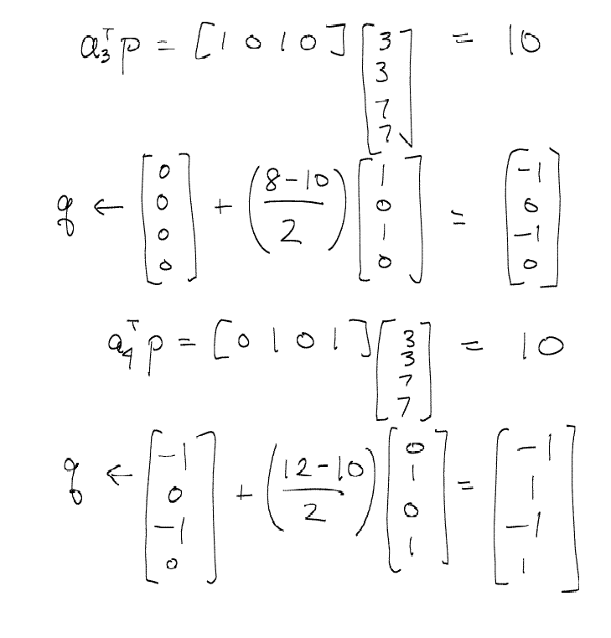

Slide 16
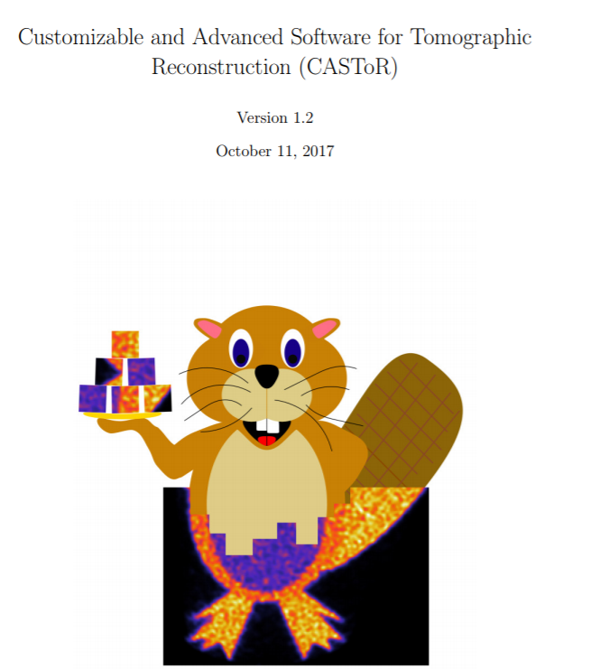

Slide 17
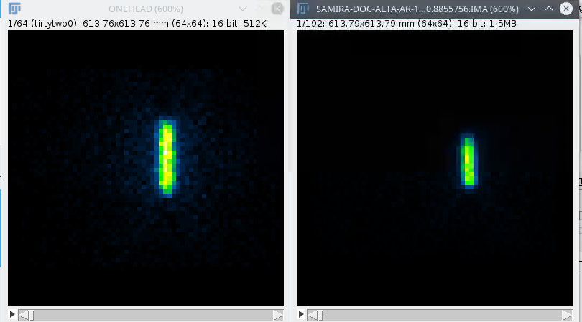
Simulated Experimental

Slide 18
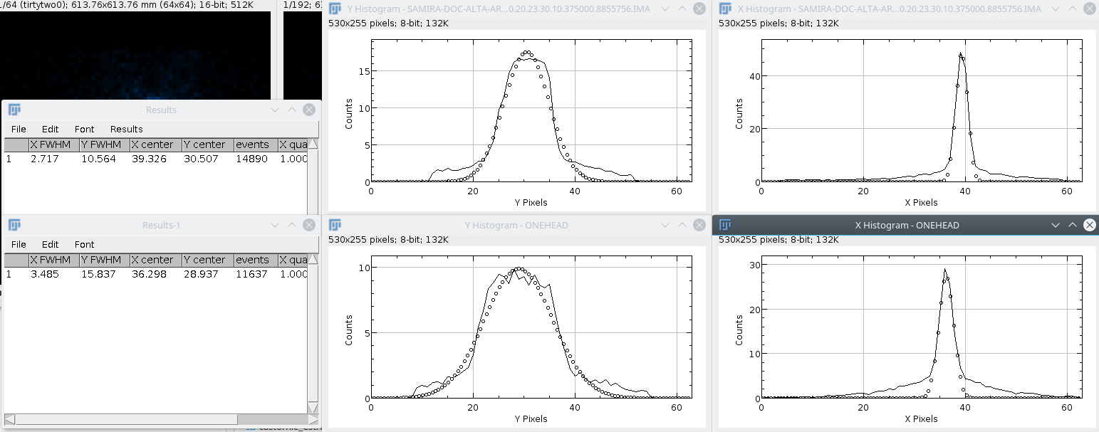

Slide 19
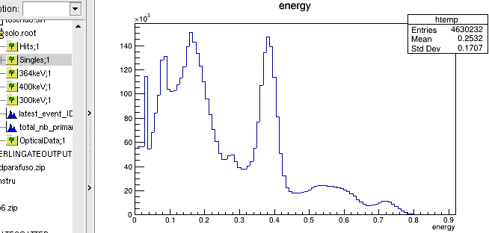

Slide 20
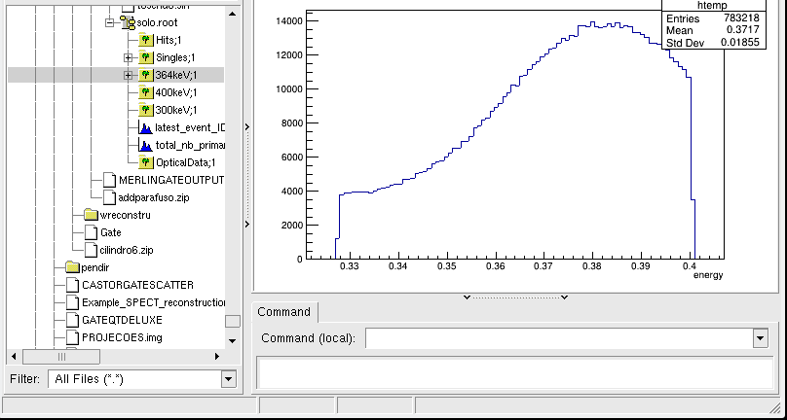

Slide 21
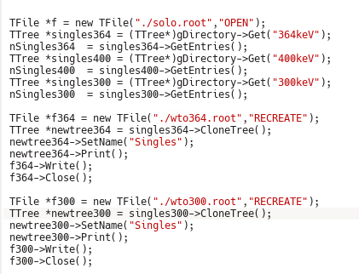

Slide 23
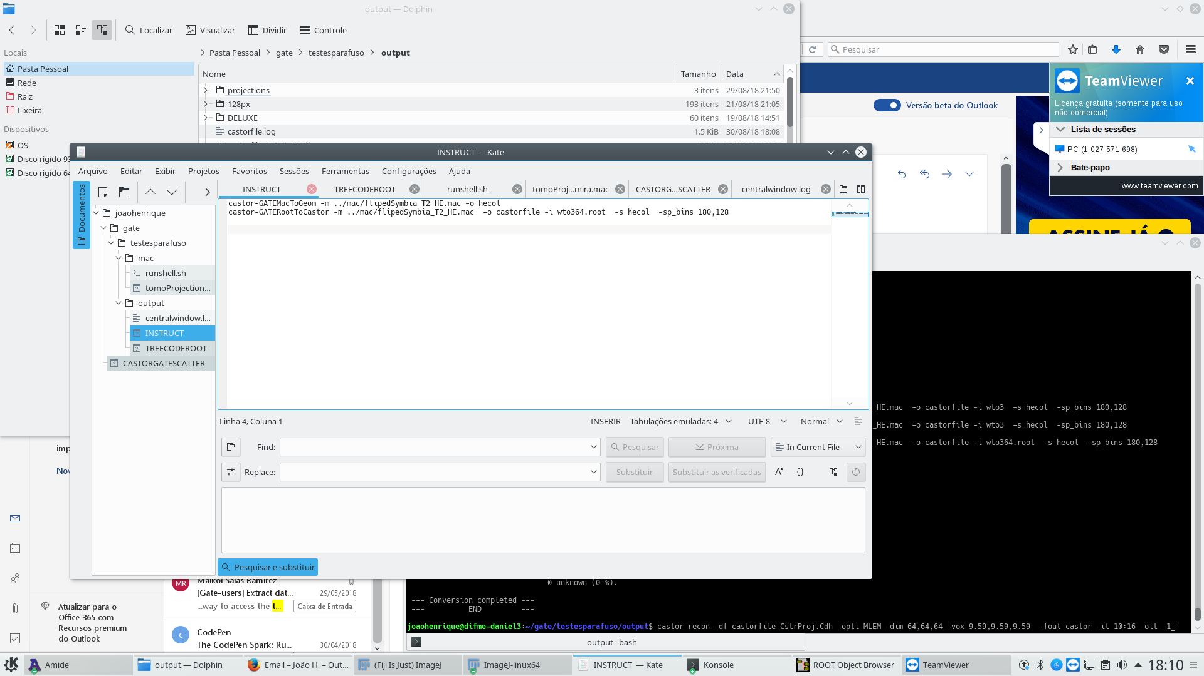
mac
data
output

Slide 24
If the last line does not work, and it`s complaining about time slice, add those lines from the main macro in the SPECT macro.

Slide 25
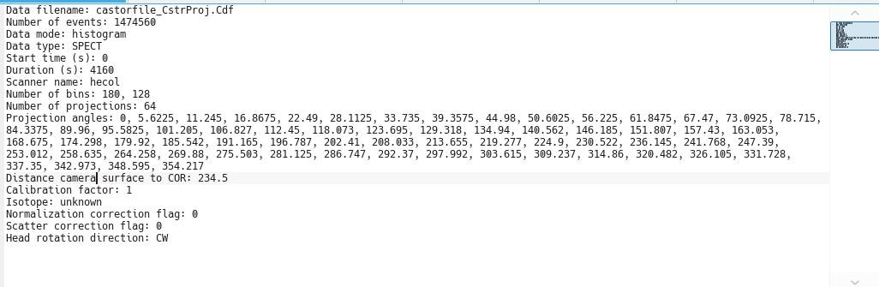
Global distance camera to surface to COR : 234.5

Slide 26
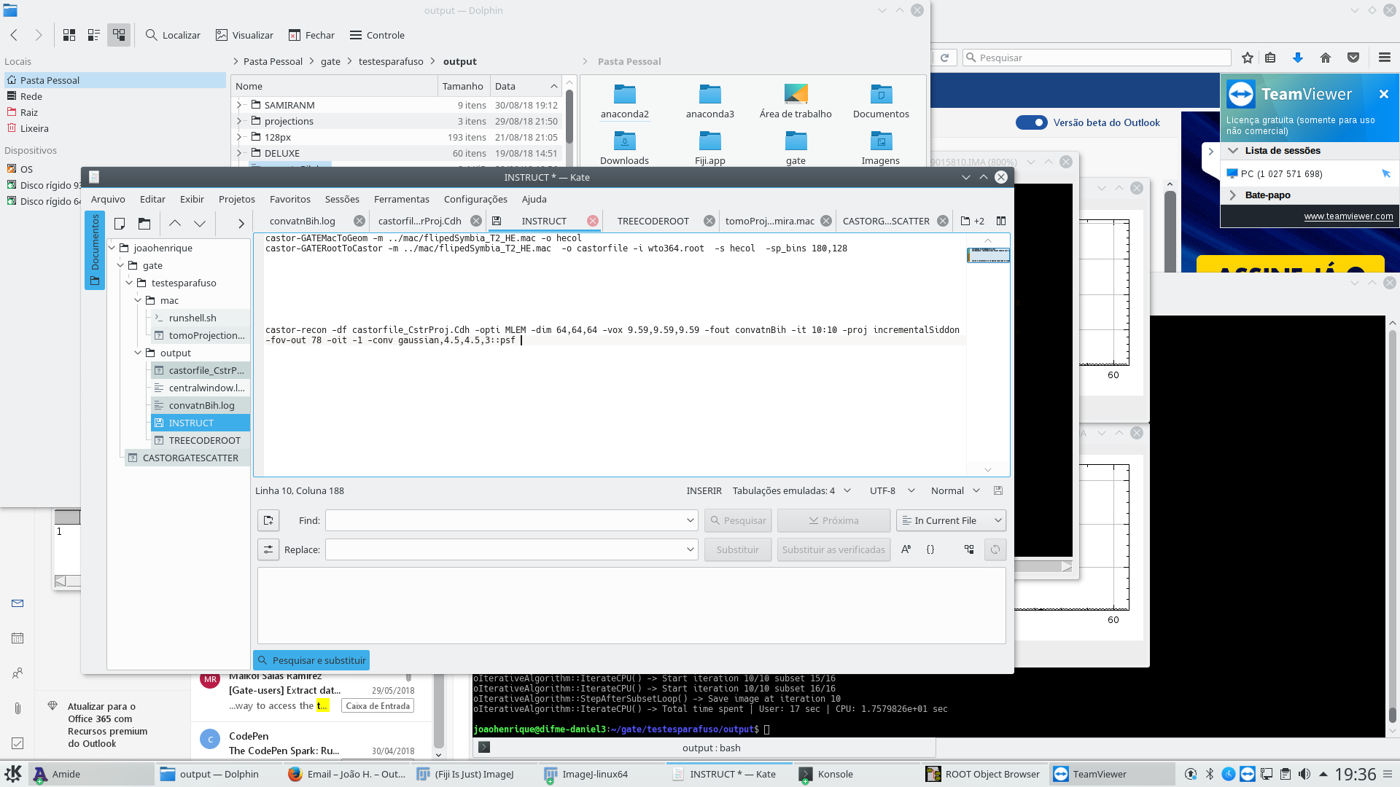

Slide 27
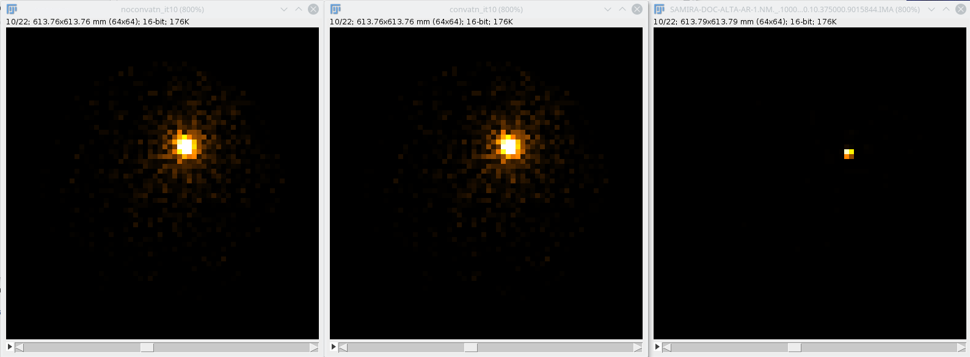
22 SLICES

Slide 28
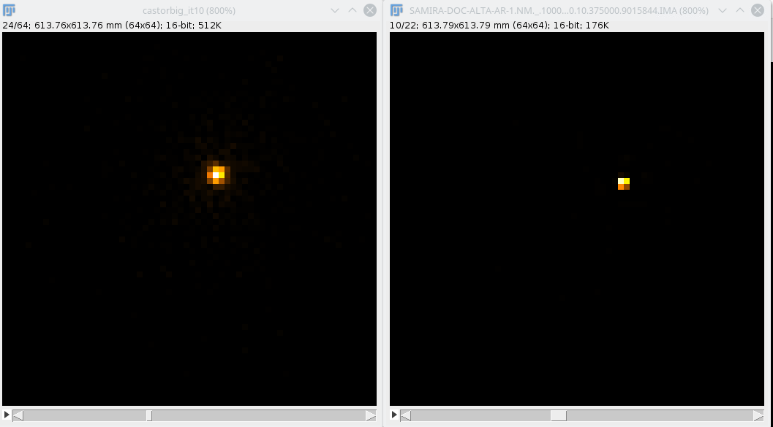
64 SLICES

Slide 29
What now?
Cubic voxel geometry asks for cubic reconstruction volume!

Slide 30
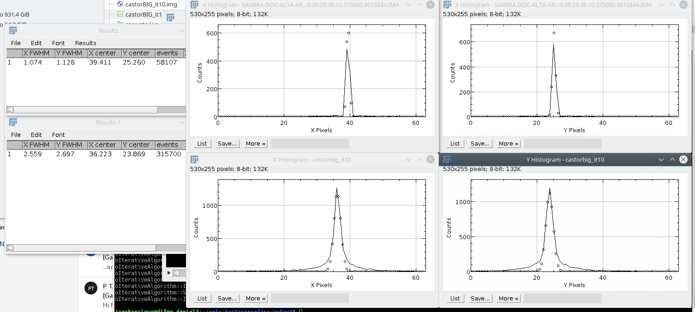
Simulated Experimental

Slide 31
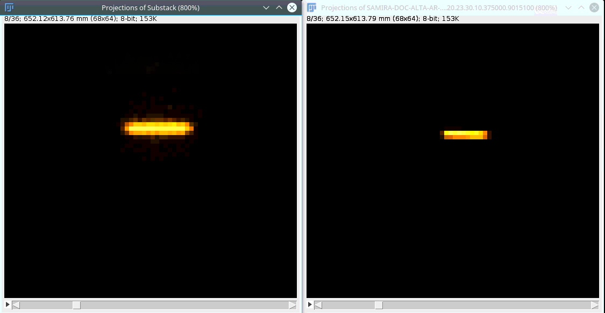
Simulated Experimental

Slide 32
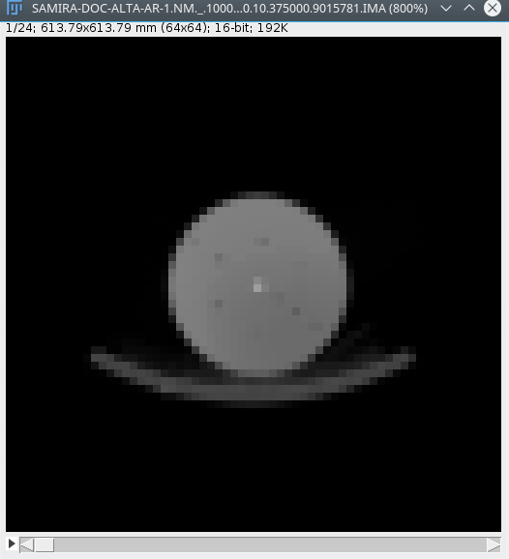
ATTENUATION CORRECTION

Slide 33
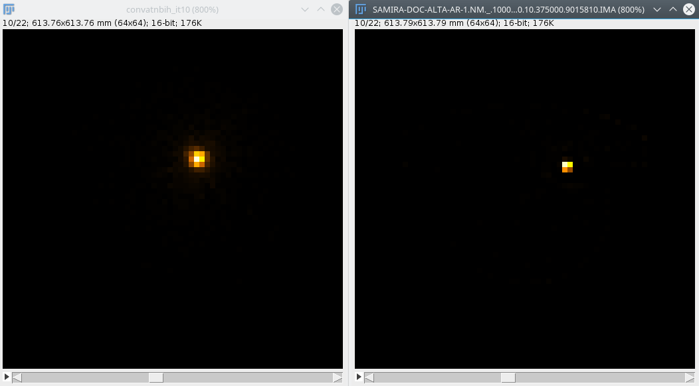
Simulated Experimental

Slide 34
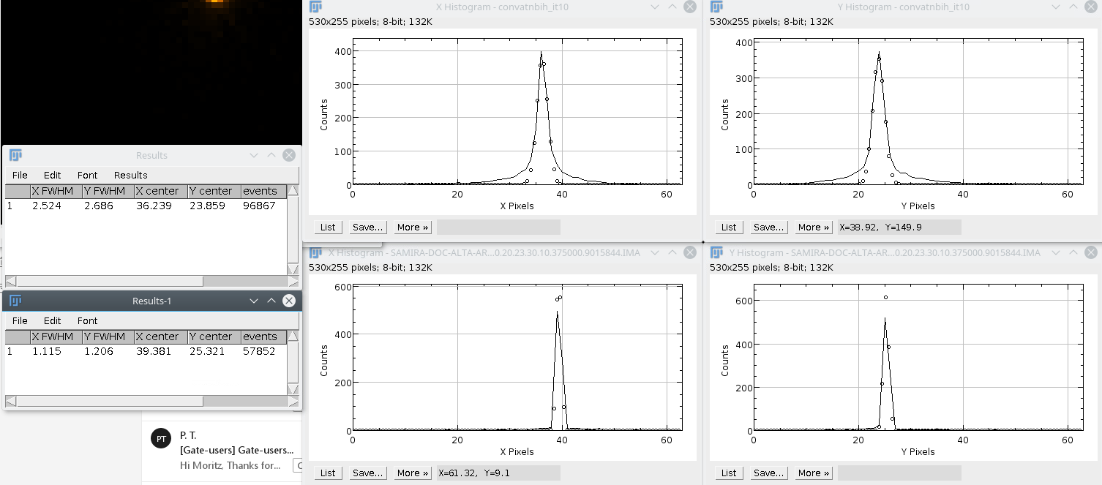
Simulated Experimental

Slide 35
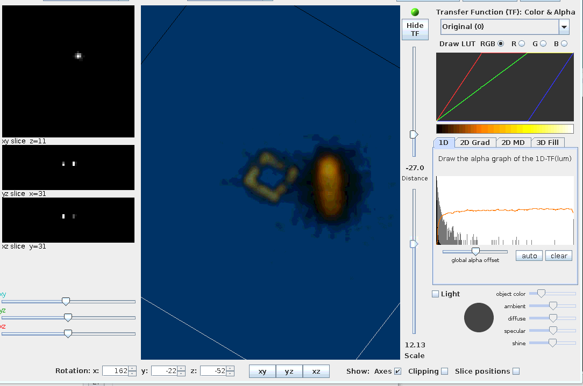
?

Slide 36
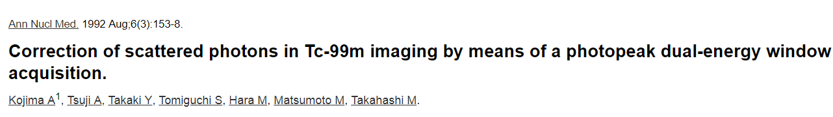
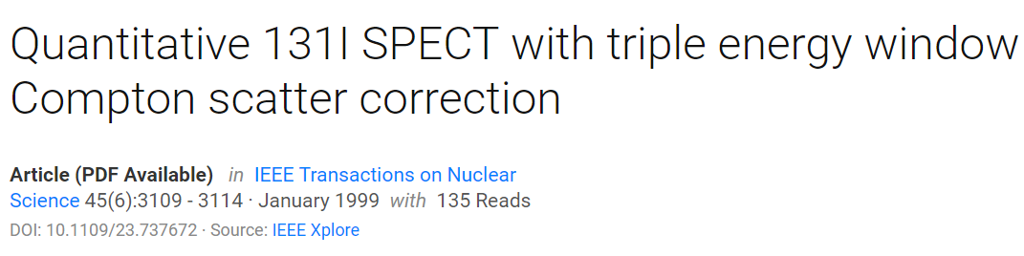

Slide 37
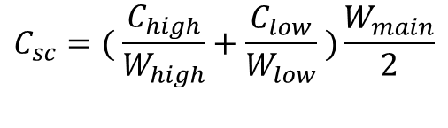
Triple Energy Window
$$C_{sc}=( \frac{C_{high}}{W_{high}}+\frac{C_{low}}{W_{low}} )\frac{W_{main}}{2}$$

Slide 38
ROOT-CASTOR does not have room for scatter info.

Slide 39
But it exists at the direct conversion to cdF e cdH.

Slide 40
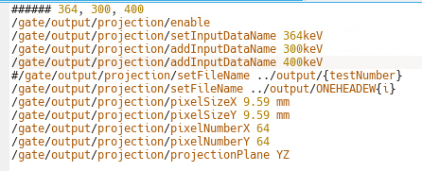

Slide 41
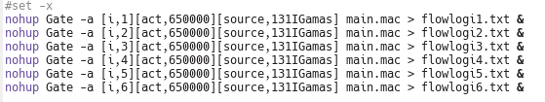
How I save time

Slide 42
hadd full.root split1.root split2.root splitn.root

Slide 43
It`s easier to work on projections than ROOT files. (I think)

Slide 44

Let`s code!

Slide 45
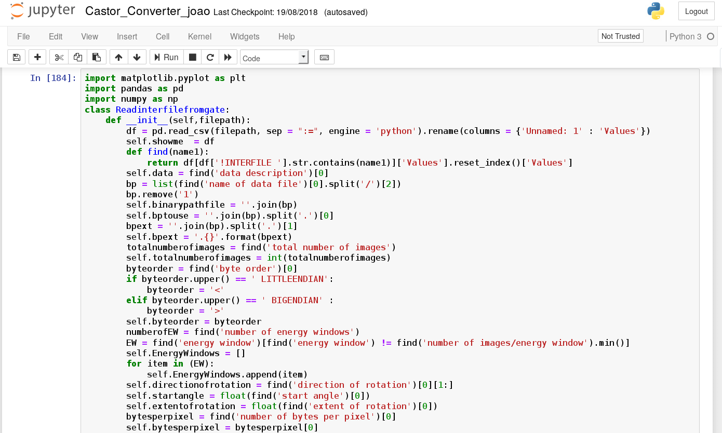

Slide 46
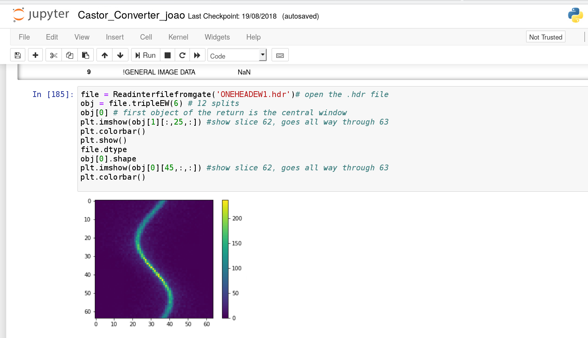

Slide 47
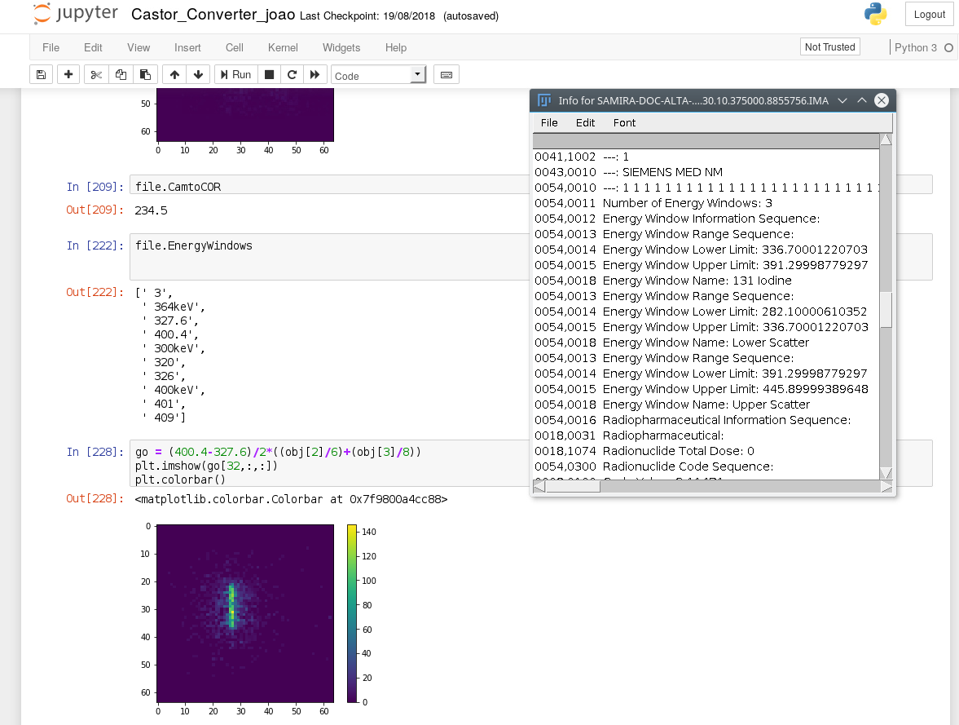

Slide 48
Projections to cdH and cdF

Slide 49
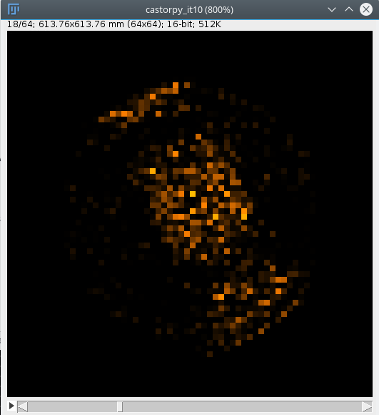

Slide 50
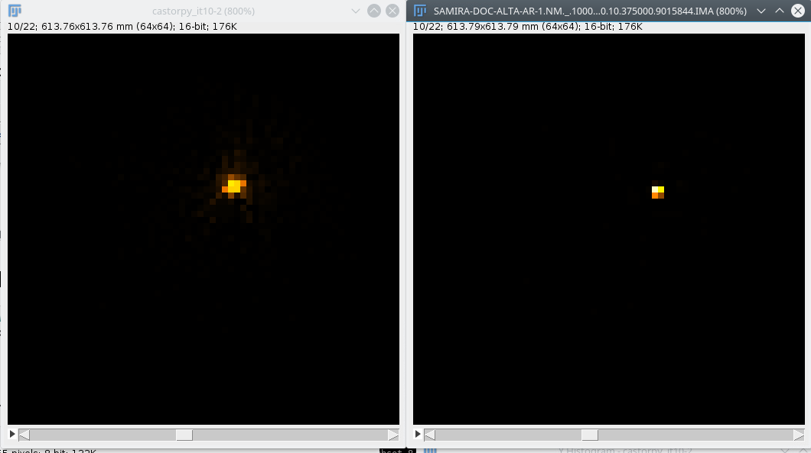
Simulated Experimental

Slide 51
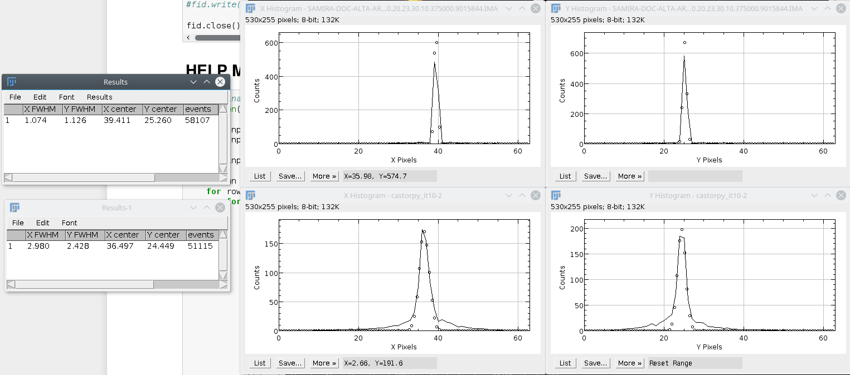
Simulated Experimental

Slide 52
Reconstruction`s not perfect!
Is the code bad?

Slide 53
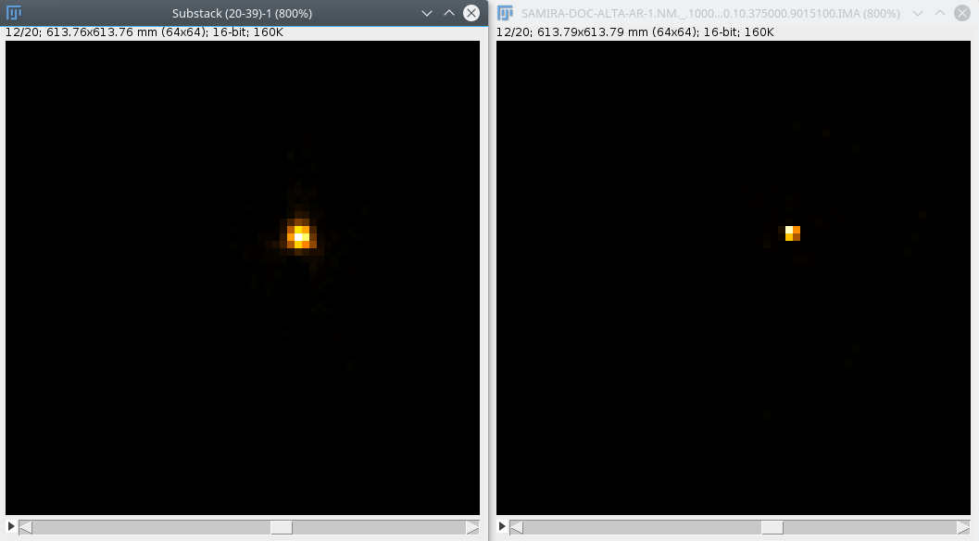
Experimental CASToR Experimental Workstation

Slide 54
% FWHM X (RefCastor/RefWorkstation) | % FWHM Y (RefCastor/RefWorkstation)
116.2 | 109.2

Slide 55
% FWHM X (Simulado/Referência) | % FWHM X (Simulado/Referência)
28.2 | 49.9
Central window | 114.2 | 119.5
AC | 101.7 | 132.2
AC+SC | 182.8 | 75.7

Slide 56

https://github.com/SimpleITK/SimpleITK/blob/master/Examples/DicomSeriesFromArray/DicomSeriesFromArray.py

Slide 57

https://fiji.sc/
Adrian-FWHM
NucMed
https://imagej.nih.gov/ij/plugins/fwhm/
http://www.med.harvard.edu/JPNM/ij/plugins/NucMed.html

Slide 58
Agradecimentos especiais
Igor Vieira CRCN
James Scuffham
ROYAL SURREY COUNTY HOSPITAL NHS FOUNDATION TRUST
Daniel Bonifácio IRD
T. Merlin CASToR
Uwe Pietrzyk GATE

